Slide 1
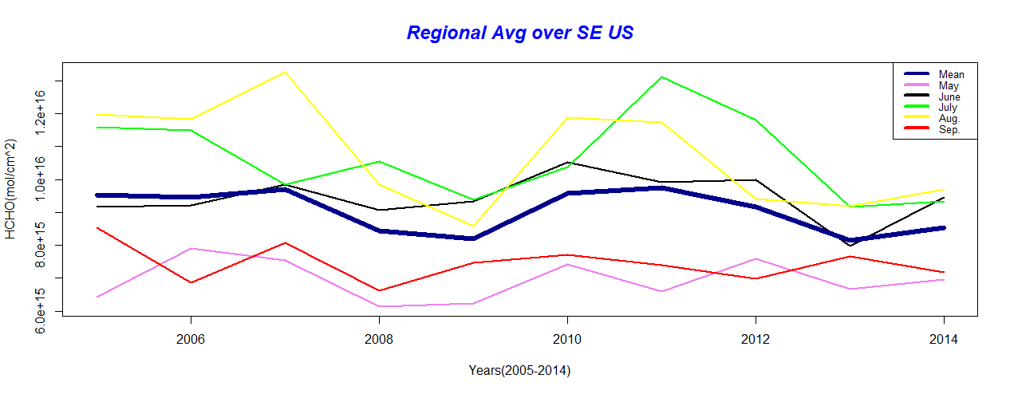
Notes:
Above plot represents the time series of regional avg HCHO columns from 2005 to 2014 for 5 different months. Plot reveals that the late summer months ( July and August) have the maximum values for all the years. The possible reasons for this are the relatively higher amount of isoprene emissions during these vegetation growing months and relatively higher amount of biomass burning and forest fires.

Slide 2
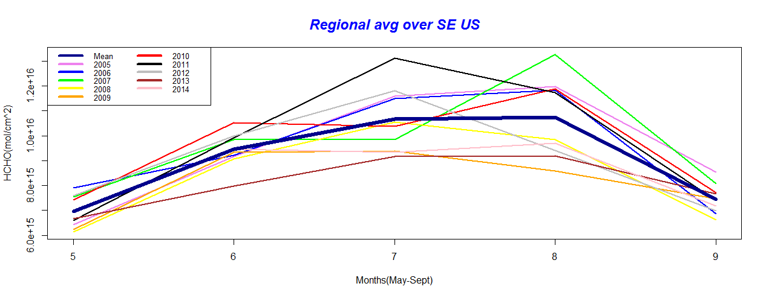
Notes:
Above plot represents the time series of regional avg HCHO columns from May to September for ten different years (2005 to 2014). Plot reveals that the late summer months ( July for drought year 2011 and August for 2007) have the maximum values among all months and years. The possible reasons for this are same as discussed in above slide.
The maximum avg value for May is found to be in 2006, for June in 2010 and for Sept. in 2005. This variation in months for highest values for different years depicts that there is no trend for HCHO data that can be easily generalized.

